Slide 1
Yellow opties

Slide 2
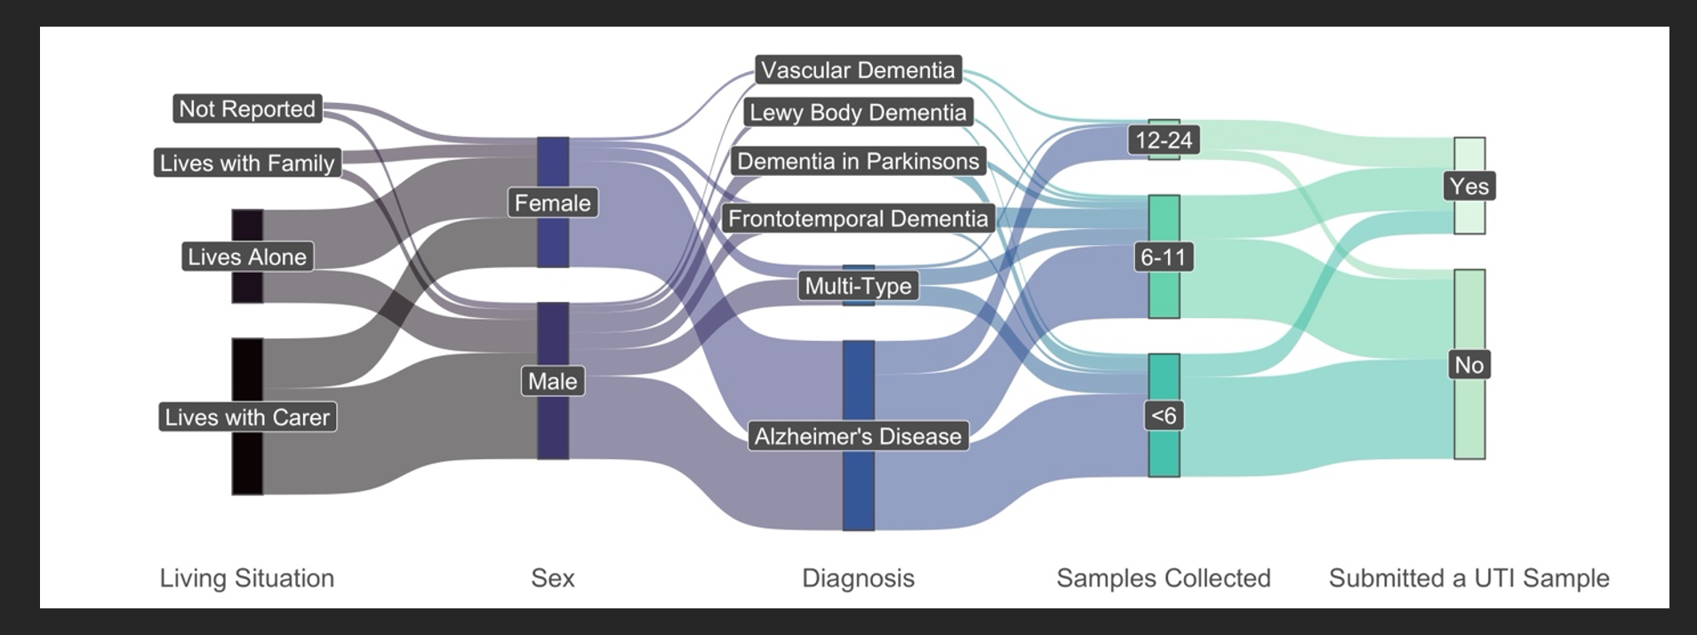

Slide 3
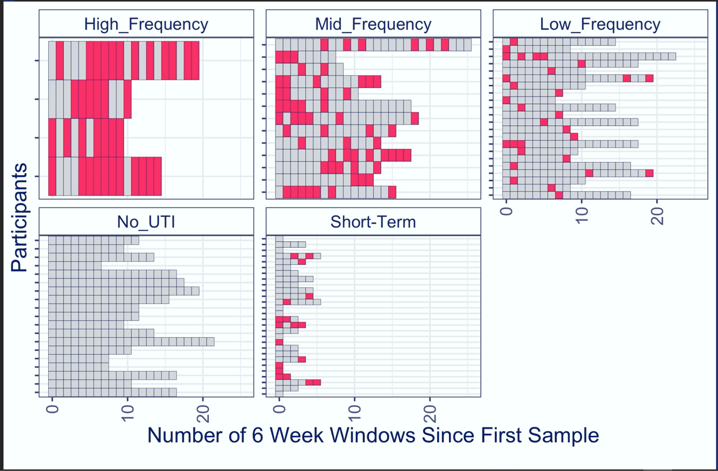

Slide 4
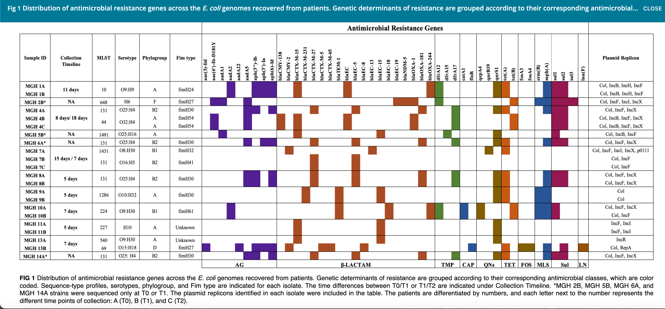
El Chaar M et al . 2024. Longitudinal genomic surveillance of multidrug-resistant Escherichia coli carriage in critical care patients. Microbiol Spectr 12:e03128-23. https://doi.org/10.1128/spectrum.03128-23 Colonization with multidrug-resistant Escherichia coli strains causes a substantial health burden in hospitalized patients. We performed a longitudinal genomics study to investigate the colonization of resistant E. coli strains in critically ill patients and to identify evolutionary changes and strain replacement events within patients.

Slide 5
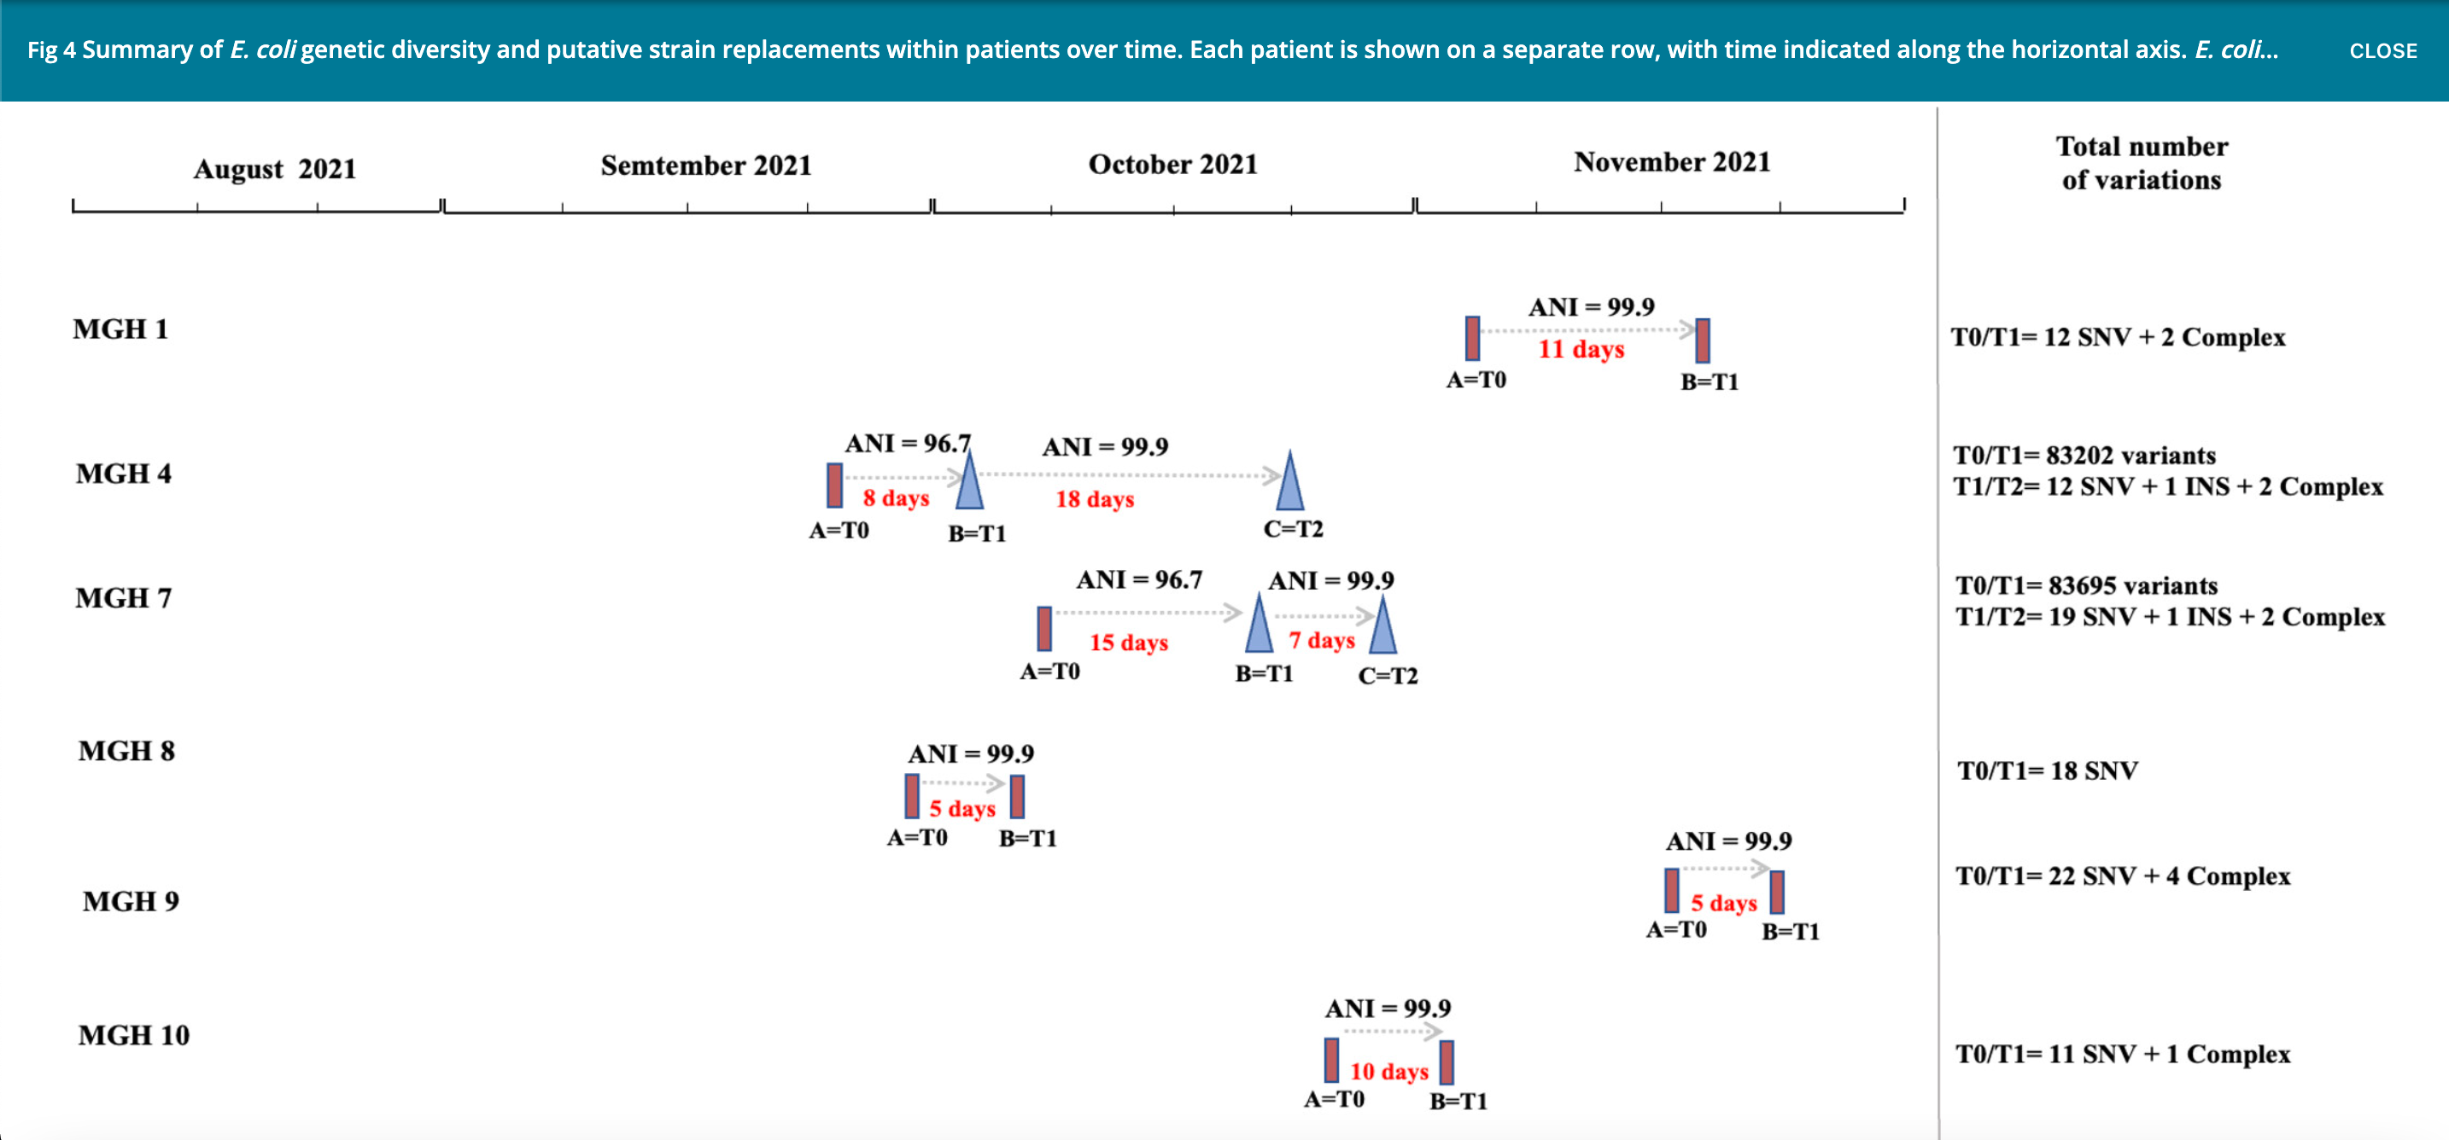
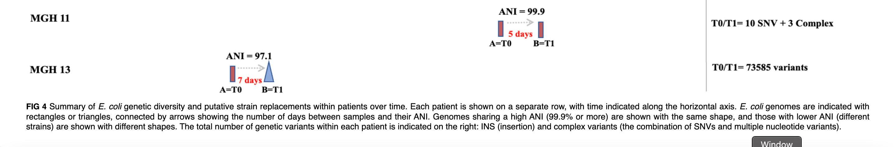

Slide 6
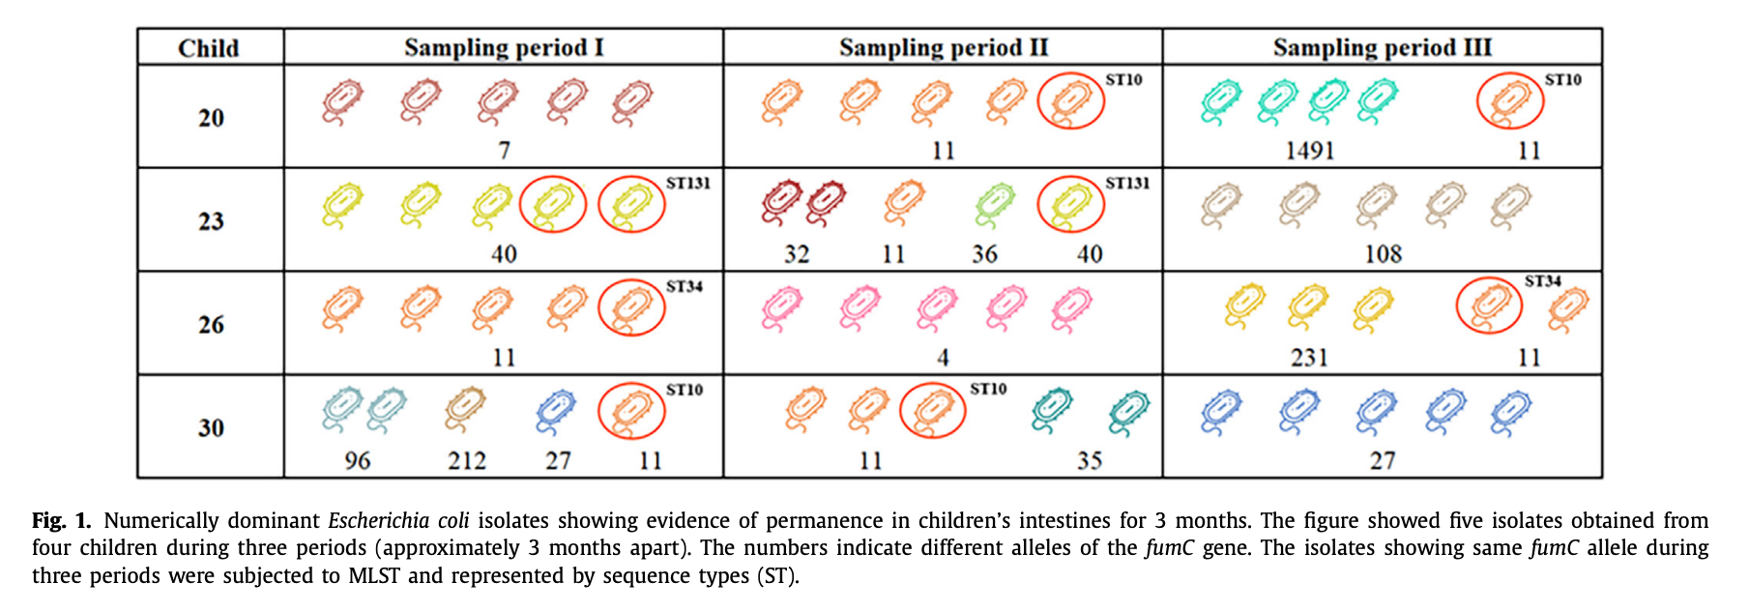
A longitudinal study of dominant E. coli lineages and antimicrobial resistance in the gut of children living in an upper middle-income country Author links open overlay panel - Diana Calderón et al

